Slide 1
Riak 201: Learning to Share
Basho Professional Services

Slide 3

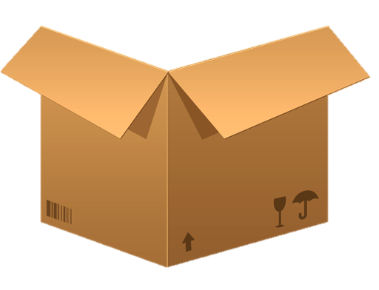
Notes:
-- We have a database, MySQL for example

Slide 4


Notes:
-- Now we add some data, and eventually the box fills up.
Used to contain data
Designed, contains 2
Contains:
Samurai
Santa Clauses

Slide 5



Notes:
-- What happens when we run out of space?
At some point you have too much data to fit on one server
More objects, different objects?
Too many objects for one box
What do you do?
Traditionally in the relational world, you might scale vertically and just buy a bigger box, but this only works for so long if your data continues to grow

Slide 6
Notes:
-- One solution might be separate your data sort of chronologically. (You add more machines to store things. This creates a problem, where do things go, and how do you get them?)
A typical scheme looks like this
All things of this type go here
- map, based on type
But what are the problems?
- only 1 Dr. Who
- No body wants to be a hall monitor
- everyone wants to be a cowboy
- No Samurai’s left, Tom Cruize was the last one
Imbalance
Where do you put new things?
Resource misallocation
Eventually you’ll have to rebalance
User ids 1-1000 goes in box 1,
User ids 1000-2000 goes in box 2, etc
But what happens if users 1-1000 stop using your service or become stagnant – you’d be wasting resources on a potentially unutilized box – and you’d likely have hot and cold spots in your “cluster” creating difficult to manage access patterns

Slide 7





???
cowboys
hall monitors
samurai
dr. whos
Notes:
Another solution might be to shard based on the type of data.
This can again result in wasted resources and hot spots if you happen to have a lot more cowboy data than samurai
You might also end up not having an appropriate place for new data if you add more functionality

Slide 8
Notes:
How do we solve this problem?

Slide 9

(
)
hash_me
= 0
Claus, Santa
0
1
2
3
Notes:
So what do we do?
Instead of using some classification to determine where to put the data
We take the key, and perform a hash function on that key, to get a 180 bit integer
we use a consistent hash function on the key.
Always converts the key to the same number
Divide up the possible number ranges

Slide 10
Consistent Hashing
Notes:
We call this consistent hashing
Our version of sharding
What this gives us is this: (next slide)

Slide 11








(
)
hash_me
= 0
Claus, Santa
0
1
2
3
Notes:
Data is now evenly distributed
resources are evenly utilized
The guy with the map knows where every object should go
Think about how clever that is
- all you need is the function, which doesn’t change
-- Applying this approach to the rest of our data, we are able to spread objects out evenly across the entire cluster
This results in reduced hot spots for certain types of data, and more even utilization of resources for all of your boxes

Slide 12
0 to …
… to …
… to …
… to 2¹⁶⁰
Notes:
We use the SHA-1 hash function, which, given a bucket/key, gives us a number between 0 and 2^160
Give each one of these partitions a range
So we’re able to evenly distribute data and evenly utilize resources
But what if we need to add a physical node?
We’d have to change the ranges, and find all the objects that need to move, so we can re -shuffle

Slide 13
Notes:
So what do we need?
We want an object to always live in the same partition, so we don’t have to rehash the object or sift through all the objects
But we also want physical nodes to be able to change what portion of the ring it’s responsible for?
So what do we do?

Slide 14

2¹⁶⁰
0
2¹⁶⁰/2
Notes:
We divide up the 160bit number into a large number of partitions, and then put multiple partitions on physical nodes, depending on how many physical nodes are in the cluster
This is a much smaller number than normal in order to make the boxes visible
- you’ll see upwards of 512 in the wild
Multiple partitions can live on a physical node
When nodes join or leave a cluster, these partitions can be passed around
- instead of sifting through objects
So on top of the consistent hashing function, we also now need a mapping of which partitions live on which physical node

Slide 15
The Ring
Notes:
This is what we call “The Ring”
You’ll see this
- app.config – ring_creating_size
- docs – some properties/state are passed in the ring
The the main purpose of the ring is defining the partitions of the 160bit number (next slide)

Slide 16
2¹⁶⁰
0
partitions
ring_size = 16
2¹⁶⁰/2
Notes:
-- Partitions are independent of physical servers or Riak nodes, and they are managed by processes in Riak called virtual nodes or vnodes.

Slide 17
2¹⁶⁰
0
2¹⁶⁰/2
Notes:
-- Here we see that each Riak Node (the guy with the map) is responsible for a group of partitions in the ring.
You’ll notice that no two red partitions are next to each other in the Ring – this is to ensure that replica data is evenly spread around
( Draw a simple cluster and the replica routing for 3 copies of data on the whiteboard if there are questions about how this protects replicas )

Slide 18
Notes:
-- For a ring size of 16, or 16 total partitions for your ring’s address space, each Riak node running would be responsible for four partitions

Slide 19

node
vnode
(vee-node)
Notes:
-- As mentioned before, each of these partitions is managed by an Erlang process running in Riak called a vnode.
Since vnodes and partitions have a 1 to 1 ratio, you’ll sometimes hear the terms partition and vnode used interchangeably

Slide 20
where to?
Notes:
-- So now when we get new pieces of data like santa clause…

Slide 21
here
over there
this way to your partition, sir.
over there
over there
Notes:
-- He can find his way to the correct vnode no matter which node receives the put request from the client

Slide 23
Ownership Handoff
Notes:
Now I’d like to talk about what happens to these partitions when we add a new node to the mix.
The partitions need to be rebalanced, and this process is called Handoff

Slide 24
Notes:
-- Here is our four node cluster from before, each with 4 partitions

Slide 25
i’m here to help!
Notes:
-- A new node is added to ease the load on the rest of the cluster

Slide 26
Notes:
-- Using the Gossip protocol to chat with each other, the nodes decide which existing partitions can be handed off to the new guy.
Since our ring size of 16 isn’t divisible by 5, most nodes will have 3 partitions now, and one node will have 4

Slide 27
Notes:
-- This is what our partition mapping looks like after handoff is complete

Slide 28
Ownership Handoff: planned operations
Notes:
Now that we’ve talked about ownership hand-offs in a normal cluster state, lets talk about what happens in a failure state

Slide 29
Hinted Handoff

Slide 30
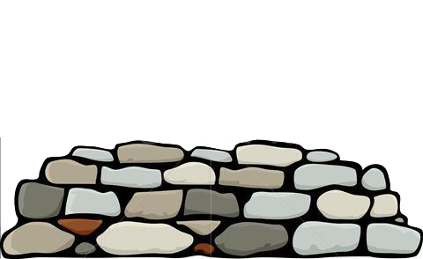
here
right this
way sir
Notes:
-- Lets say a pile of rocks falls on one of your servers

Slide 31
here
where to?
right this
way sir
Notes:
-- Here comes ‘ol santa clause looking for his vnode

Slide 32
here
right this
way sir
where’d
he go?
over th…
Notes:
-- The node that receives the request hashes his name and finds that he should be directed to the red node… but where’d the red node go?

Slide 33
here
right this
way sir
hang here
for a bit.
Notes:
-- During the absence of the red node, the rest of the nodes will claim ownership of the partitions red used to handle as if it were a cluster of 3 ndoes instead of four

Slide 34
i’m back!
gah, finally!
Notes:
-- If the red node comes back online and is rediscovered by the rest of the cluster via Gossip protocol, the handoff process begins to return the partitions back to red’s ownership

Slide 35
sonny!
mama!
Notes:
-- The process of neighboring nodes taking temporary ownership of the partitions of a downed node is called…

Slide 36
Hinted Handoff: unplanned events
Notes:
Hinted handoff
This differs from regular handoff because it happened as the result of an unexpected change in the cluster, not from intentionally adding or removing a node

Slide 38
Consistent Hashing
(evenly distributes data)
Notes:
To review
Consistent Hashing removes the guess work from sharding and
Evenly distributes data

Slide 39
The Ring
(data partitions, evenly divided among nodes)
Notes:
The ring is made up of Partitions in the address space of 0 to 2¹⁶⁰
Each of those partitions is managed by a vnode
Which are divided as evenly as possible amongst the nodes

Slide 40
Partition Handoffs 1) Ownership handoff (planned) 2) Hinted handoff (failure modes)
Notes:
Ownership Handoff – happens as intentional administration
Hinted Handoff – happens in failure modes

Slide 41
Riak 201: Learning to Share
Basho Professional Services

